Slide 1
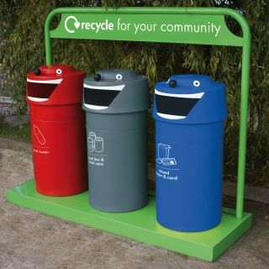
Project:
Solid dry & wet waste segregating bin(using Arduino)
By: Group-14
Daksh Goel-220559
Viresh Chauhan-220422
Daksh Bhadra-220600
Akshay Korapti-220583

Slide 2
Introduction
Currently in the market there exists bins, appropriately known as smart bins, that provide touchless lid opening service. While few other dustbins that falls under the HI-END tag comes with services such as a capacity notifier, odour control and self sealing technology.
Our goal is to make segregating waste easy at home.
Objectives:
Segregate dry and wet waste automatically.
Notify about the space left in each compartment.
Provide messages using LCD screen.

Slide 3

Hardware & Software:
Hardware:
Plywood-Base
Arduino- brain
Breadboard-circuit
IR sensor-Presence detection
Ultrasonic sensor-Space detection
Motors-movement
Software:
Arduino IDE
Tinker cad
SCHOOL OF ENGINEERING AND TECHNOLOGY

Slide 4
Methodology:
Our model is intended to be used in household kitchens to help segregate dry and wet waste automatically.
We have achieved this by using a capacitive soil moisture sensor to detect the wetness of a material.
The moisture sensor is attached to a lightweight board(sun board) that is connected to a dc motor (we collectively call this board arm), the IR sensor placed above the moisture sensor is used to detect the presence, in this case garbage.
When the IR sensor detects the garbage it sends the signal to the moisture sensor to check the wetness of the garbage.
If the garbage is wet, then it falls into the wet compartment (right side) or else into the dry section (left side) with the help of the motor.
SCHOOL OF ENGINEERING AND TECHNOLOGY

Slide 5
Methodology:
Inside each compartment we have placed an ultrasonic sensor to detect the space inside the compartment. If the space exceeds the limit that is set (in this case 7 inches) the sensor sends a signal to the LCD screen to display that the compartment is full.
The LCD placed outside displays the necessary information generally, if the garbage is dry or wet, the value of the garbage the moisture sensor has measured, notification prompts to display the space inside the compartment, etc.
SCHOOL OF ENGINEERING AND TECHNOLOGY

Slide 6
Experimental Results:
The model is able to differentiate between dry and wet waste.
It is also able to detect how much space is left.
The model is able to display the required notifications on the LCD screen.
SCHOOL OF ENGINEERING AND TECHNOLOGY

Slide 7
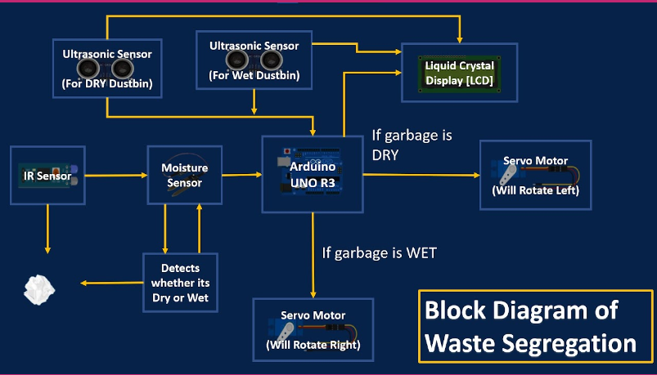
Block Diagram:
SCHOOL OF ENGINEERING AND TECHNOLOGY

Slide 8
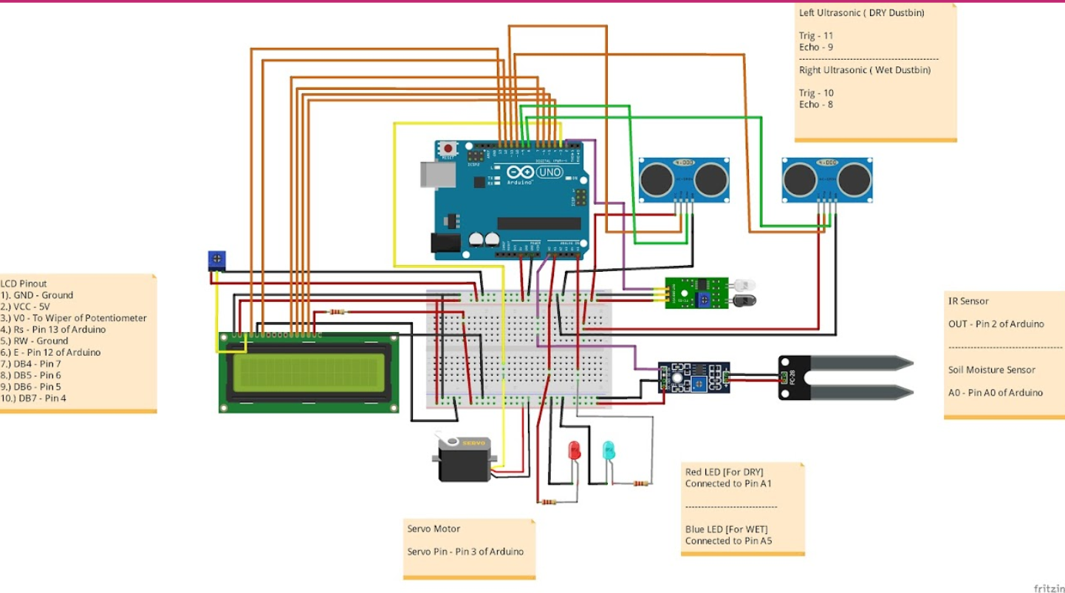
Circuit Diagram:
SCHOOL OF ENGINEERING AND TECHNOLOGY

Slide 9
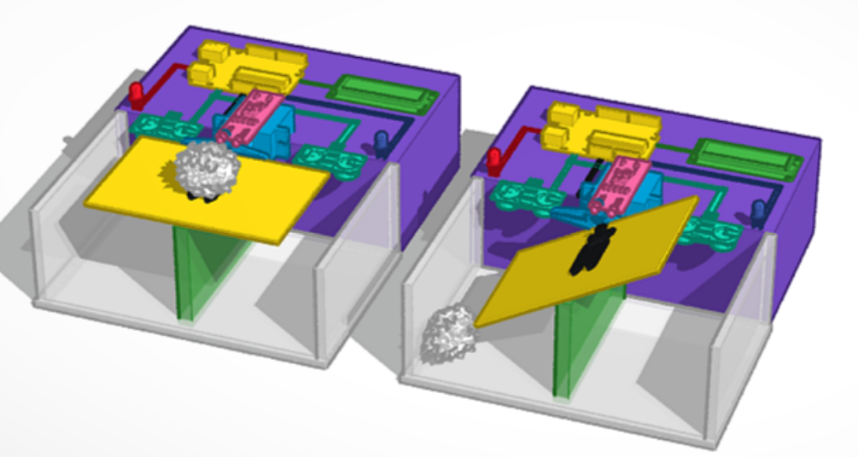
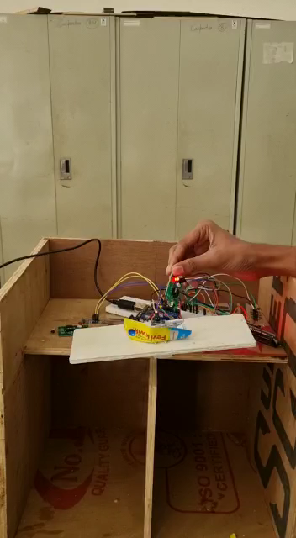
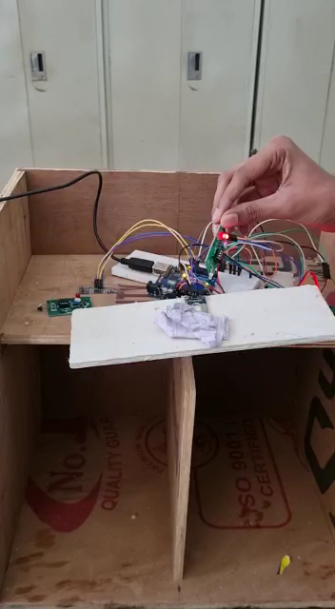
Demonstration

Slide 10
Future Scope
Currently our project falls short in many areas as we lack the advanced knowledge for better implementation. But the future scope is quite vast.
In future, we can implement a better way to segregate the garbage without using the moisture sensor.
we can provide notifications via Bluetooth on our smartphones rather than displaying on an LCD screen and etc.
The project has a lot of potential and with appropriate knowledge and skills it can be a better and more refined version.

Slide 11
References
https://youtu.be/JFt8l9Ei8Hw
Link to our code for the dustbin:
https://drive.google.com/file/d/1gcTAgo2kVZYGQWidhe97eUHvf6zCTRP1/view?usp=sharing

Slide 12
END

